Slide 1

E6895 Advanced Big Data Analytics Task Milestone 3:
Visual Exploration of Large Graph in Immersive Environment
Sam Guleff [SG2665]
February 2nd, 2017

Slide 2

Milestone Goals
Milestone I – Research, Setup & Design
Milestone II – Build Fundamentals and Demo
Milestone III – Advance & Extend Capabilities
Aspirational – External Connections & Advanced Interactions

Slide 3
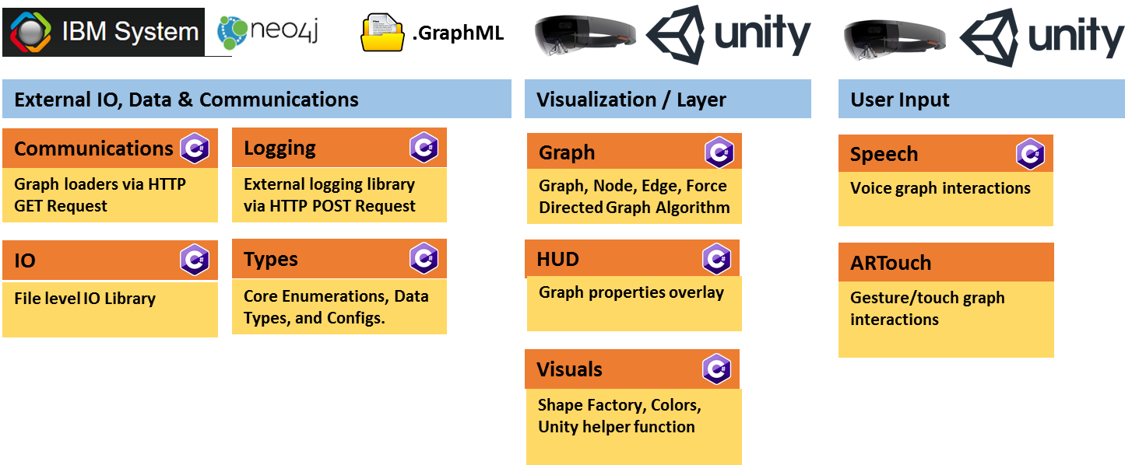
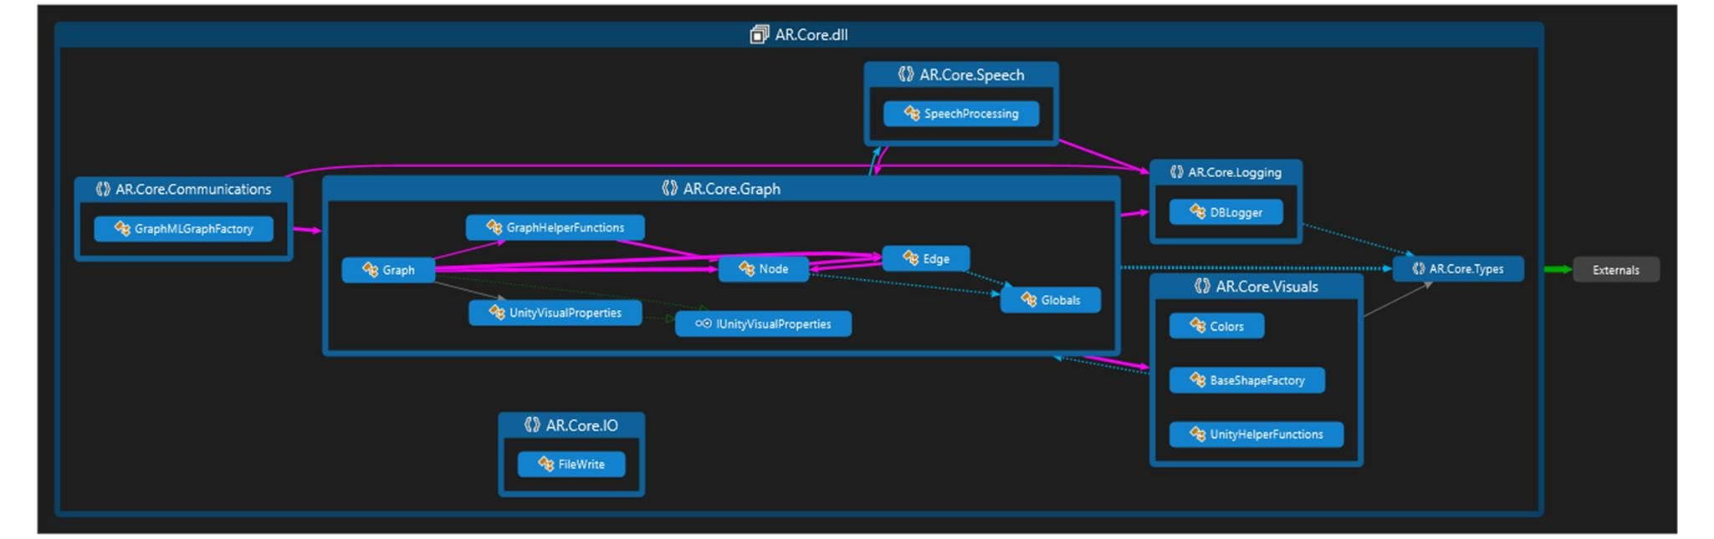
Milestone III – Current Library Architecture

Slide 4




Milestone III – Interactivity Architecture
CursorManager
GestureManager
TextToSpeechManager
VoiceManager
Handles Curser Views
Handles users gestures e.g. clicks
Handles converting text to speech
Relays graph properties to speech
GazeManager
InteractibleManager
SpeechProcessing
SpeechManager
Head Tracking of cursor
Handles interactions of gaze with UI elements
Handles Interactible events to TextToSpeech
Handles most voice tasks for end user
GazeStabilizaer
Smooths Head Tracking of cursor

Slide 5

Milestone III – Interactivity Architecture
Graph Properties – Give Graph properties
Dense – Show highly connected components
Reset – Reset graph to default state
Load Simple Graph – Loads a baseline simple graph via GraphX
Load Sample Graph – Loads a more complex graph via GraphX
Load Database Graph – Loads Neo4j Graph
Depth First Search – Visualizes a Depth first search against the graph from arbitrary node
Breadth First Search - Visualizes a Depth first search against the graph from arbitrary node
Move Nodes – Randomly moves nodes
Disable Speech – Disables text to speech
Enable Speech – Enables text to speech
Sample voice commands
Nodes – Clicking on nodes voices node properties
Edges – Clicking on edges voices edge properties
Sample touch

Slide 6
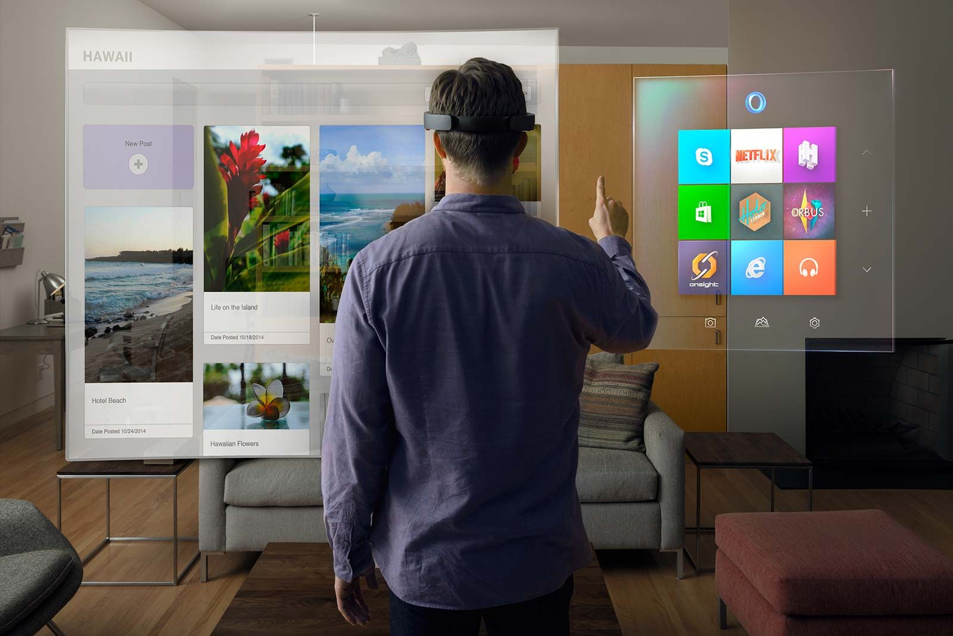
Milestone III – Demo
https://youtu.be/W9XvaVNsGpw
https://youtu.be/ewQ6mcEEFqc

Slide 7


Lessons Learned & Last Steps
Lessons Learned
Use only Core .NET & Unity Libraries:
Embedded Resource, File Transfer, Database(s) [Retrieving Graph]
Using Database Libraries Failed – NPGSQL, SQLite [storing debug logs]
Parsing Json from Neo4j Retrieval
For Unity Objects
Getting proper context to objects and event handling
Next Steps
Coneectivity with other groups data
Text and implement all necessary functions
Build out Neo4j functionality:
Improve connectivity and property parsing
Graph interactions:
Visualize graph properties
Scale out to larger graphs:
Current limits to objects are relatively low

Slide 8

Questions

